Slide 1
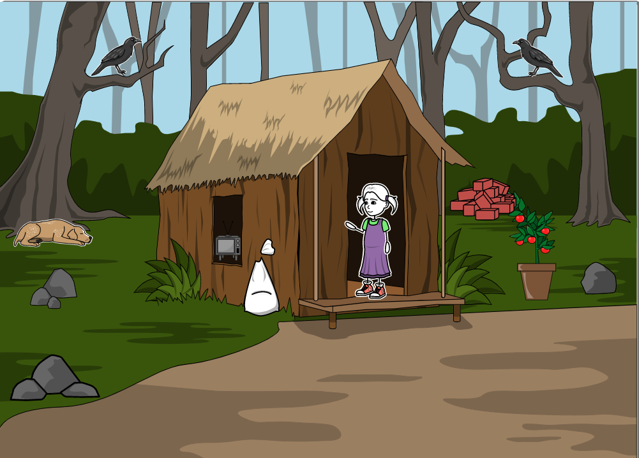
oh! what a beautiful bus ride!
here, valli is admiring the bus that is passing through her road
Notes:
Listening please this is the way of

Slide 3
It is true for any linear equation that each solution (x, y) of a linear equation in two variables,
ax + by + c = 0, corresponds to a point on the line representing the equation, and vice versa.

Slide 4
Three possible solutions for a given pair of linear equations:

Slide 5
The two lines will intersect at one point. (Intersecting lines)
The two line will not intersect, i.e, they are parallel. (Parallel lines)
The two lines will be coincident. (Coincident lines over lap)

Slide 6
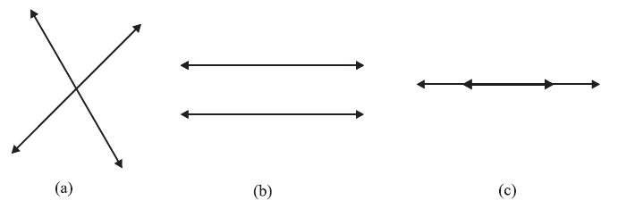

Slide 8
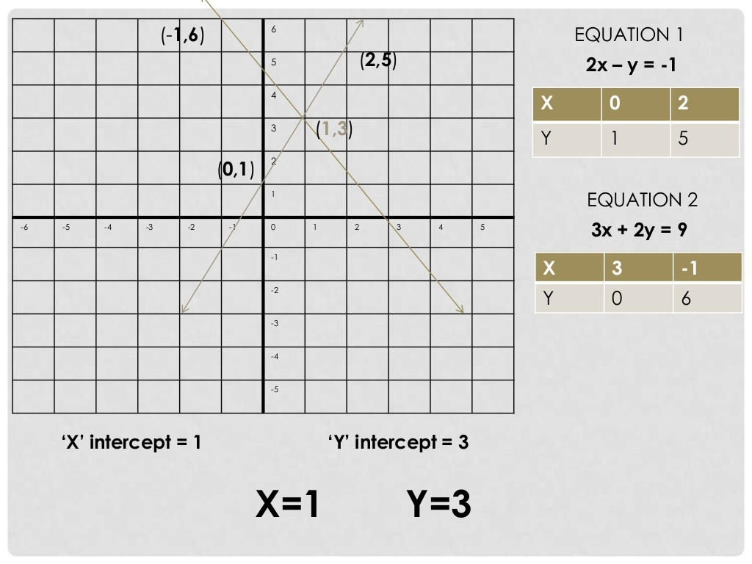

Slide 9
Consistent and Inconsistent pair of Linear equations
(i) the lines may intersect in a single point. In this case, the pair of equations has a unique solution (consistent pair of equations).
(ii) the lines may be parallel. In this case, the equations have no solution (inconsistent pair of equations).
(iii) the lines may be coincident. In this case, the equations have infinitely many solutions [dependent (consistent) pair of equations].

Slide 10
Comparison of
Ratios

Slide 14
